Slide 1







docker
f o r b e g i n n e r s

Slide 2

Objectives
What are Containers?
What is Docker?
Why do you need it?
What can it do?
Run Docker Containers
Create a Docker Image
Networks in Docker
Docker Compose
Docker Concepts in Depth
Docker for Windows/Mac
Docker Swarm
Docker vs Kubernetes

Slide 3

docker
o v e r v i e w

Slide 4






Why do you need docker?
Web Server
Database
Messaging
Orchestration
Compatibility/Dependency
Long setup time
Different Dev/Test/Prod environments
The Matrix from Hell !!
Libraries
Dependencies
OS
Hardware Infrastructure

Slide 5
What can it do?
Container
Container
Container
Container
Containerize Applications
Run each service with its own dependencies in separate containers
Web Server
Database
Messaging
Orchestration
Libs
Deps
Libs
Deps
Libs
Deps
Libs
Deps
Docker
?
OS
Hardware Infrastructure

Slide 6
What are containers?
Processes Network
Mounts
Processes Network
Mounts
Processes
Network Mounts
Processes Network
Mounts
Docker
OS Kernel

Slide 7




Operating System
OS
Software
Software
Software
Software
OS Kernel

Slide 8


Sharing the kernel
Software
Software
Software
Software
Docker
OS - Ubuntu

Slide 9




Containers vs Virtual Machines
✓
✓
✓
✓
✓
GB
MB
Size
✓
Utilization Size
Virtual Machine
Boot up
Utilization
Boot up
Virtual Machine
Container
Container
Application
Application
Application
Application
Libs
Deps
Libs
Deps
OS
OS
Libs
Deps
Libs
Deps
Hypervisor
Docker
OS
Hardware Infrastructure
Hardware Infrastructure

Slide 10
Containers & Virtual Machines
Virtual Machine Container Container
Virtual Machine Container Container
Libs Deps
Libs Deps
Application
Application
Application
Application
Libs
Deps
Libs
Deps
Docker
Docker
OS
OS
Hypervisor
OS
Hardware Infrastructure
Hardware Infrastructure

Slide 11







How is it done?
Public Docker registry - dockerhub
docker run ansible
docker run mongodb docker run redis docker run nodejs docker run nodejs docker run nodejs

Slide 12

Container vs image
Docker Container #1
Docker Image
Package Template Plan
Docker Container #2
Docker Container #3

Slide 13

d o c k e r
Getting Started

Slide 14
Docker Editions
Community Edition
Enterprise Edition

Slide 15





Community Edition
Linux
MAC
Windows
Cloud

Slide 16
docker
c o m m a n d s

Slide 17


Run – start a container
docker run nginx
Unable to find image 'nginx:latest' locally latest: Pulling from library/nginx fc7181108d40: Already exists
d2e987ca2267: Pull complete 0b760b431b11: Pull complete Digest:
sha256:96fb261b66270b900ea5a2c17a26abbfabe95506e73c3a3c65869a6dbe83223a
Status: Downloaded newer image for nginx:latest

Slide 18



ps – list containers
docker ps
CONTAINER ID 796856ac413d
IMAGE
nginx
COMMAND
"nginx -g 'daemon of…"
CREATED
7 seconds ago
STATUS
Up 6 seconds
PORTS
80/tcp
NAMES
silly_sammet
docker ps -a
CONTAINER ID 796856ac413d
cff8ac918a2f
IMAGE
nginx redis
COMMAND
"nginx -g 'daemon of…"
"docker-entrypoint.s…"
CREATED
7 seconds ago
6 seconds ago
STATUS
Up 6 seconds
Exited (0) 3 seconds ago
NAMES
silly_sammet relaxed_aryabhata

Slide 19


STOP – stop a container
docker ps
CONTAINER ID 796856ac413d
IMAGE
nginx
COMMAND
"nginx -g 'daemon of…"
CREATED
7 seconds ago
STATUS
Up 6 seconds
PORTS
80/tcp
NAMES
silly_sammet
docker stop silly_sammet
silly_sammet
docker ps -a
CONTAINER ID IMAGE
796856ac413d nginx cff8ac918a2f redis
COMMAND
CREATED
STATUS
NAMES
"nginx -g 'daemon of…"
7 seconds ago
Exited (0) 3 seconds ago
silly_sammet
"docker-entrypoint.s…"
6 seconds ago
Exited (0) 3 seconds ago
relaxed_aryabhata

Slide 20



Rm – Remove a container
docker rm silly_sammet
silly_sammet
docker ps -a
CONTAINER ID
cff8ac918a2f
IMAGE
redis
COMMAND
"docker-entrypoint.s…"
CREATED
6 seconds ago
STATUS
Exited (0) 3 seconds ago
NAMES
relaxed_aryabhata

Slide 21

images – List images
docker images
REPOSITORY TAG IMAGE ID CREATED SIZE nginx latest f68d6e55e065 4 days ago 109MB
redis | latest | 4760dc956b2d | 15 | months | ago | 107MB
ubuntu | latest | f975c5035748 | 16 | months | ago | 112MB
alpine | latest | 3fd9065eaf02 | 18 | months | ago | 4.14MB

Slide 22

rmi – Remove images
docker rmi nginx
Untagged: nginx:latest
Untagged: nginx@sha256:96fb261b66270b900ea5a2c17a26abbfabe95506e73c3a3c65869a6dbe83223a Deleted: sha256:f68d6e55e06520f152403e6d96d0de5c9790a89b4cfc99f4626f68146fa1dbdc Deleted: sha256:1b0c768769e2bb66e74a205317ba531473781a78b77feef8ea6fd7be7f4044e1 Deleted: sha256:34138fb60020a180e512485fb96fd42e286fb0d86cf1fa2506b11ff6b945b03f Deleted: sha256:cf5b3c6798f77b1f78bf4e297b27cfa5b6caa982f04caeb5de7d13c255fd7a1e
! Delete all dependent containers to remove image

Slide 23

Pull – download an image
docker run nginx
Unable to find image 'nginx:latest' locally latest: Pulling from library/nginx fc7181108d40: Already exists
d2e987ca2267: Pull complete 0b760b431b11: Pull complete Digest:
sha256:96fb261b66270b900ea5a2c17a26abbfabe95506e73c3a3c65869a6dbe83223a Status: Downloaded newer image for nginx:latest
docker pull nginx
Using default tag: latest
latest: Pulling from library/nginx fc7181108d40: Pull complete
d2e987ca2267: Pull complete 0b760b431b11: Pull complete Digest:
sha256:96fb261b66270b900ea5a2c17a26abbfabe95506e73c3a3c65869a6dbe83223a Status: Downloaded newer image for nginx:latest

Slide 24



docker run ubuntu
docker ps
CONTAINER ID
IMAGE
COMMAND
CREATED
STATUS
PORTS
docker ps -a
CONTAINER ID
45aacca36850
IMAGE
ubuntu
COMMAND
"/bin/bash"
CREATED
43 seconds ago
STATUS
Exited (0) 41 seconds ago
PORTS

Slide 25





docker run ubuntu
docker ps
CONTAINER ID
IMAGE
COMMAND
CREATED
STATUS
PORTS
docker ps -a
CONTAINER ID
45aacca36850
IMAGE
ubuntu
COMMAND
"/bin/bash"
CREATED
43 seconds ago
STATUS
Exited (0) 41 seconds ago
PORTS

Slide 26


Append a command
docker run ubuntu
docker run ubuntu sleep 5
34512

Slide 27

Exec – execute a command
docker ps -a
CONTAINER ID
538d037f94a7
IMAGE
ubuntu
COMMAND
"sleep 100“
CREATED
6 seconds ago
STATUS
Up 4 seconds
NAMES
distracted_mcclintock
docker exec distracted_mcclintock cat /etc/hosts
127.0.0.1 localhost
::1 localhost ip6-localhost ip6-loopback fe00::0 ip6-localnet
ff00::0 ip6-mcastprefix ff02::1 ip6-allnodes ff02::2 ip6-allrouters
172.18.0.2 538d037f94a7

Slide 28




Run – attach and detach
docker run kodekloud/simple-webapp
This is a sample web application that displays a colored background.
Serving Flask app "app" (lazy loading)
Running on http://0.0.0.0:8080/ (Press CTRL+C to quit)
docker run kodekloud/simple-webapp
a043d40f85fefa414254e4775f9336ea59e19e5cf597af5c554e0a35a1631118
–d
docker attach a043d

Slide 29

d o c k e r
run

Slide 30


Run – tag
docker run redis
Using default tag:
latest
latest: Pulling from library/redis f5d23c7fed46: Pull complete Status: Downloaded newer image for
redis:latest
1:C 31 Jul 2019 09:02:32.624 # oO0OoO0OoO0Oo Redis is starting oO0OoO0OoO0Oo
1:C 31 Jul 2019 09:02:32.624 # bits=64, commit=00000000, modified=0,
1:M 31 Jul 2019 09:02:32.626 # Server initialized
pid=1, just started
Redis version=5.0.5,
docker run
redis:4.0
TAG
Unable to find image 'redis:4.0' locally 4.0: Pulling from library/redis e44f086c03a2: Pull complete
Status: Downloaded newer image for redis:4.0
1:C 31 Jul 09:02:56.527 # oO0OoO0OoO0Oo Redis is starting oO0OoO0OoO0Oo
1:C 31 Jul 09:02:56.527 # Redis
version=4.0.14,
bits=64, commit=00000000, modified=0, pid=1, just started
1:M 31 Jul 09:02:56.530 # Server initialized

Slide 31



RUN - STDIN
~/prompt-application$ ./app.sh
Mumshad
Hello and Welcome Mumshad!
Welcome! Please enter your name:
docker run kodekloud/simple-prompt-docker
Hello and Welcome !
docker run
–i
kodekloud/simple-prompt-docker
Mumshad
Hello and Welcome Mumshad!
docker run kodekloud/simple-prompt-docker
Welcome! Please enter your name: Mumshad
Hello and Welcome Mumshad!
–it

Slide 32





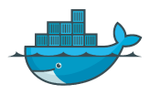

Run – PORT mapping
docker run kodekloud/webapp
http://192.168.1.5:80
* Running on http://0.0.0.0:5000/ (Press CTRL+C to quit)
80
8000
8001
IP: 192.168.1.5
http://172.17.0.2:5000
Internal IP
5000
5000
5000
docker run
kodekloud/simple-webapp
IP: 172.17.0.2
IP: 172.17.0.3
IP: 172.17.0.4
–p 80:5000
3
Web APP
Docker Container
Web APP
Docker Container
Web APP
Docker Container
3
docker run
kodekloud/simple-webapp
0
–p 8000:5000
6
3
IP: 172.17.0.5
MySQL
3
IP: 172.17.0.6
MySQL
3
IP: 172.17.0.6
MySQL
3
0 Docker
6 Container
3
0
6
3
0
6
docker run
–p 8001:5000
kodekloud/simple-webapp
Docker Container
Docker Container
docker run
mysql
8
–p 3306:3306
3
0
docker run
–p 8306:3306
mysql
6
Docker Host
docker run
–p 8306:3306
mysql

Slide 33


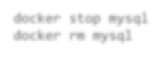



RUN – Volume mapping
docker run mysql
Data
/var/lib/mysql
/opt/datadir
MYSQL
Docker Container
Docker Host
docker stop mysql docker rm mysql
docker run
–v /opt/datadir:/var/lib/mysql
mysql

Slide 34

Inspect Container
docker inspect blissful_hopper
[
{
"Id": "35505f7810d17291261a43391d4b6c0846594d415ce4f4d0a6ffbf9cc5109048",
"Name": "/blissful_hopper",
"Path": "python", "Args": [
"app.py"
],
"State": {
"Status": "running", "Running": true,
},
"Mounts": [], "Config": {
"Entrypoint": [
"python",
"app.py"
],
},
"NetworkSettings": {..}
}
]

Slide 35

Container Logs
docker logs blissful_hopper
This is a sample web application that displays a colored background. A color can be specified in two ways.
As a command line argument with --color as the argument. Accepts one of
red,green,blue,blue2,pink,darkblue
As an Environment variable APP_COLOR. Accepts one of red,green,blue,blue2,pink,darkblue
If none of the above then a random color is picked from the above list.
Note: Command line argument precedes over environment variable.
No command line argument or environment variable. Picking a Random Color =blue
Serving Flask app "app" (lazy loading)
Environment: production
WARNING: Do not use the development server in a production environment. Use a production WSGI server instead.
Debug mode: off
Running on http://0.0.0.0:8080/ (Press CTRL+C to quit)

Slide 36
d o c k e r
e n v i r o n m e n t v a r i a b l e s

Slide 37


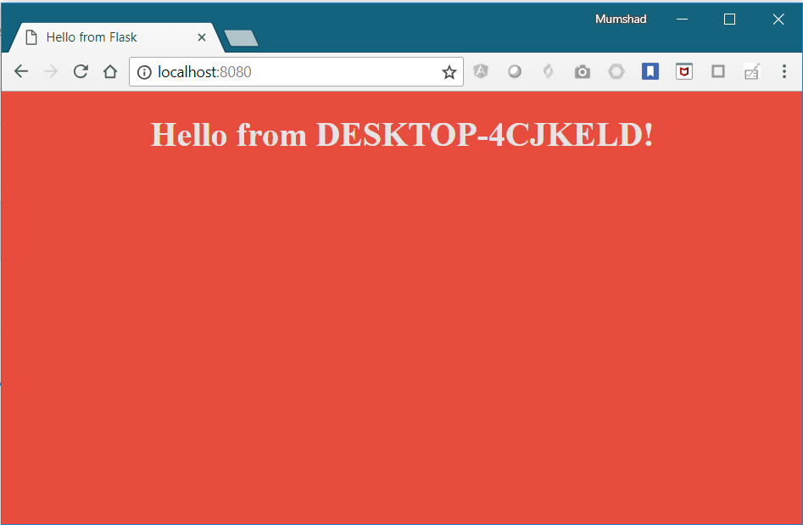


Environment Variables
app.py
import os
from flask import Flask
app = Flask( name )
…
…
color = "red"
@app.route("/")
def main():
print(color)
return render_template('hello.html', color=color)
if name == " main ":
app.run(host="0.0.0.0", port="8080")
python app.py

Slide 38


Environment Variables
app.py
import os
from flask import Flask
app = Flask( name )
…
…
color = "red"
@app.route("/") def main():
print(color)
return render_template('hello.html', color=color)
if name == " main ": app.run(host="0.0.0.0", port="8080")

Slide 39

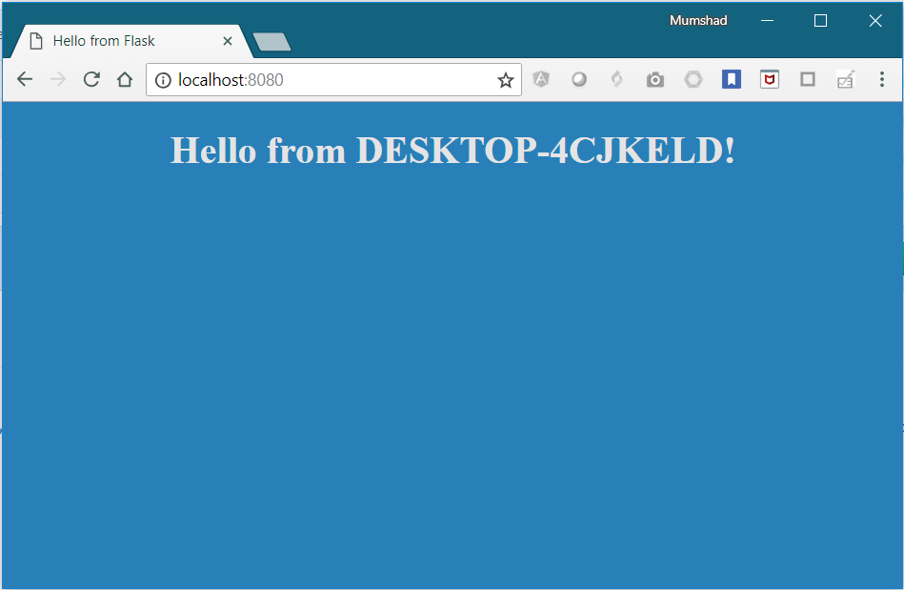

Environment Variables
app.py
import os
from flask import Flask
app = Flask( name )
…
…
color = os.environ.get('APP_COLOR')
@app.route("/") def main():
print(color)
return render_template('hello.html', color=color)
if name == " main ": app.run(host="0.0.0.0", port="8080")
"red"
export APP_COLOR=blue; python app.py

Slide 40




ENV Variables in Docker
app.py
import os
from flask import Flask
app = Flask( name )
…
…
os.environ.get('APP_COLOR')
@app.route("/") def main():
print(color)
return render_template('hello.html', color=color)
if name == " main ": app.run(host="0.0.0.0", port="8080")
color = "red"
docker run -seimAplPeP-_wCeObLaOpRp=-bclouleor

Slide 41
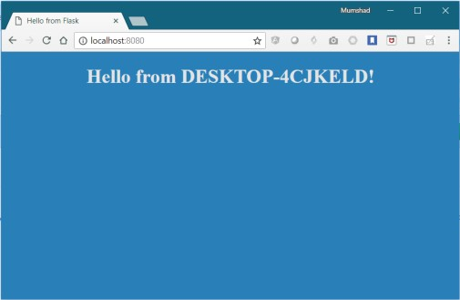

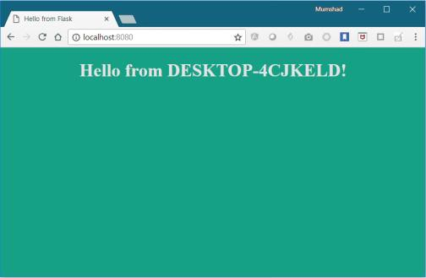
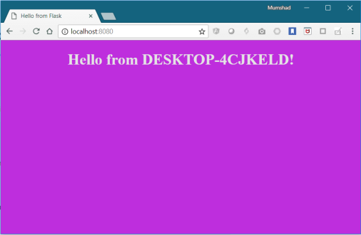
ENV Variables in Docker
docker run -e APP_COLOR=blue simple-webapp-color
docker run -e APP_COLOR=green simple-webapp-color
docker run -e APP_COLOR=pink simple-webapp-color

Slide 42
Inspect Environment Variable
docker inspect blissful_hopper
[
{
"Id": "35505f7810d17291261a43391d4b6c0846594d415ce4f4d0a6ffbf9cc5109048",
"State": {
"Status": "running", "Running": true,
},
"Mounts": [], "Config": {
"Env": [
"APP_COLOR=blue",
"LANG=C.UTF-8", "GPG_KEY=0D96DF4D4110E5C43FBFB17F2D347EA6AA65421D", "PYTHON_VERSION=3.6.6",
"PYTHON_PIP_VERSION=18.1"
],
"Entrypoint": [
"python",
"app.py"
],
}
]

Slide 43

d o c k e r
images

Slide 44

What am I containerizing?

Slide 45


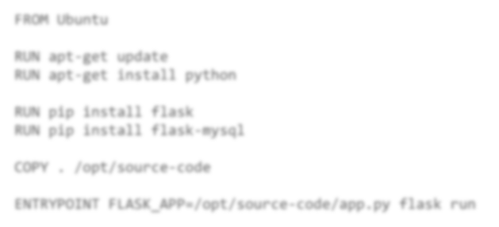



How to create my own image?
Dockerfile
FROM Ubuntu
1. OS - Ubuntu
RUN apt-get update
RUN apt-get install python
2. Update apt repo
RUN pip install flask
RUN pip install flask-mysql
3. Install dependencies using apt
4. Install Python dependencies using pip
COPY . /opt/source-code
ENTRYPOINT FLASK_APP=/opt/source-code/app.py flask run
5. Copy source code to /opt folder
6. Run the web server using “flask” command
docker build Dockerfile –t mmumshad/my-custom-app
docker push mmumshad/my-custom-app
Docker Registry

Slide 46





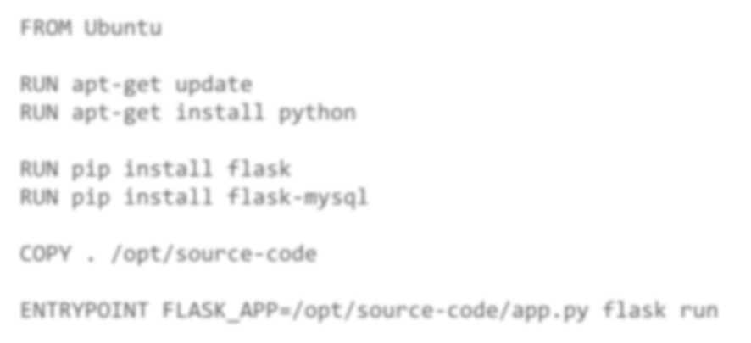

Dockerfile
Dockerfile
INSTRUCTION
ARGUMENT
Dockerfile
FROM Ubuntu
Start from a base OS or
another image
RUN apt-get update
RUN apt-get install python
Install all dependencies
RUN
pip install flask
RUN pip install flask-mysql
COPY . /opt/source-code
ENTRYPOINT FLASK_APP=/opt/source-code/app.py flask run
Copy source code
Specify Entrypoint

Slide 47


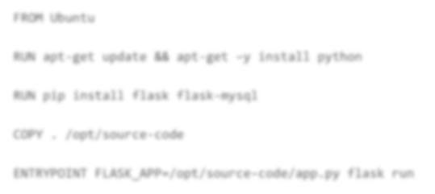




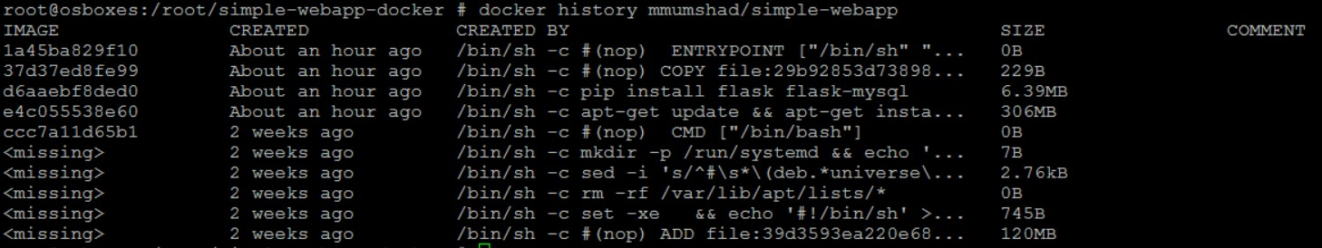
Layered architecture
Dockerfile
docker build Dockerfile –t mmumshad/my-custom-app
FROM Ubuntu
Layer 1. Base Ubuntu Layer
120 MB
RUN apt-get update && apt-get –y install python
Layer 2. Changes in apt packages
306 MB
RUN pip install flask flask-mysql
Layer 3. Changes in pip packages
6.3 MB
COPY . /opt/source-code
Layer 4. Source code
229 B
ENTRYPOINT FLASK_APP=/opt/source-code/app.py flask run
Layer 5. Update Entrypoint with “flask” command
0 B

Slide 48
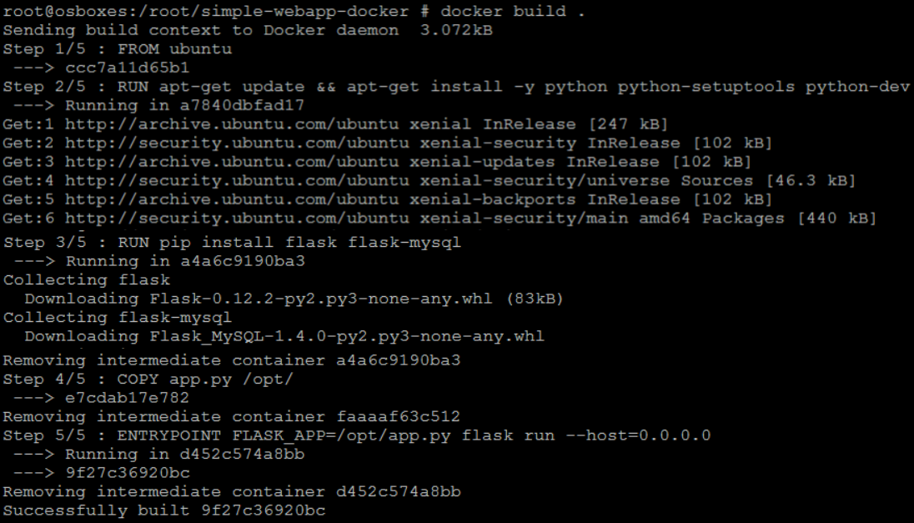
Docker build output

Slide 49

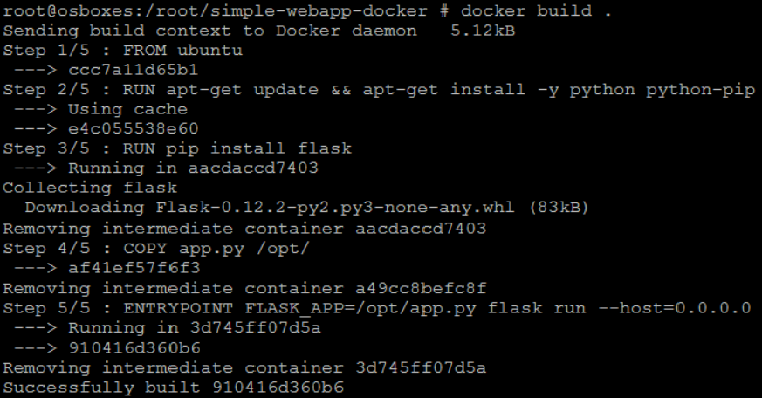


failure
docker build Dockerfile –t mmumshad/my-custom-app
Layer 1. Base Ubuntu Layer
Layer 2. Changes in apt packages
Layer 3. Changes in pip packages
Layer 4. Source code
Layer 5. Update Entrypoint with “flask” command

Slide 50

d o c k e r
networking

Slide 51








Default networks
Bridge
none
host
docker run ubuntu
docker run Ubuntu –-network=none
docker run Ubuntu --network=host
Docker Host
 | 5000 |  |  |  | 5000
Web Container |  |  |  | Web Container
Docker Host
Web
Container
172.17.0.2
Web
Container
172.17.0.3
Web
Container
172.17.0.1
docker0
172.17.0.4
Web
Container
172.17.0.5
Web
Container
Docker Host

Slide 52
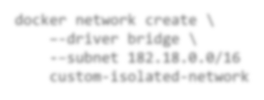


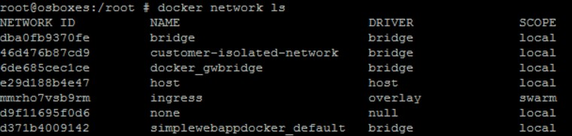
User-defined networks
Web
Container
172.17.0.2
docker network create \
–-driver bridge \
-–subnet 182.18.0.0/16 custom-isolated-network
Web
Container
1782.178.0.3
172.17.0.1
docker0
182.18.0.1
docker0
172.17.0.4
Web
Container
1782..178..0..52
Web
Container
docker network ls
Docker Host

Slide 53
Inspect Network
docker inspect blissful_hopper
[
{
"Id": "35505f7810d17291261a43391d4b6c0846594d415ce4f4d0a6ffbf9cc5109048",
"Name": "/blissful_hopper",
"NetworkSettings": { "Bridge": "",
"Gateway": "172.17.0.1",
"IPAddress": "172.17.0.6",
"MacAddress": "02:42:ac:11:00:06", "Networks": {
"bridge":
{
"Gateway": "172.17.0.1",
"IPAddress": "172.17.0.6",
"MacAddress": "02:42:ac:11:00:06",
}
}
}
]

Slide 54


Embedded DNS
Host
IP
mysql.connect( mysql )
web
Container
mysql
Container
web
172.17.0.2
172.17.0.3
172.17.0.2
172.17.0.3
mysql
172.17.0.3
docker0
DNS
Server
127.0.0.11
Docker Host

Slide 55

d o c k e r
storage

Slide 56
File system
/var/lib/docker aufs containers image volumes

Slide 57


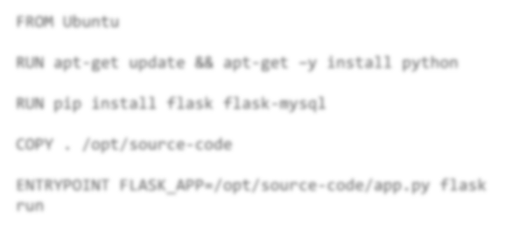
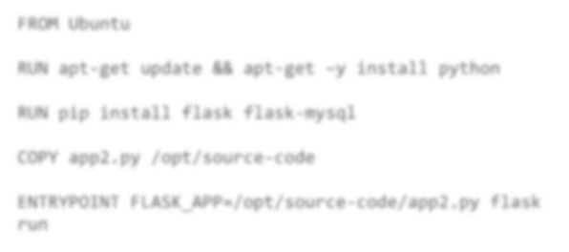











Layered architecture
Dockerfile
Dockerfile2
FROM Ubuntu
FROM Ubuntu
RUN apt-get update && apt-get –y install python
RUN apt-get update && apt-get –y install python
RUN pip install flask flask-mysql
RUN pip install flask flask-mysql
COPY . /opt/source-code
COPY app2.py /opt/source-code
ENTRYPOINT FLASK_APP=/opt/source-code/app.py flask run
ENTRYPOINT FLASK_APP=/opt/source-code/app2.py flask run
docker build Dockerfile –t mmumshad/my-custom-app
docker build Dockerfile2 –t mmumshad/my-custom-app-2
Layer 1. Base Ubuntu Layer
120 MB
Layer 1. Base Ubuntu Layer
0 MB
Layer 2. Changes in apt packages
306 MB
Layer 2. Changes in apt packages
0 MB
Layer 3. Changes in pip packages
6.3 MB
Layer 3. Changes in pip packages
0 MB
Layer 4. Source code
229 B
Layer 4. Source code
229 B
Layer 5. Update Entrypoint
0 B
Layer 5. Update Entrypoint
0 B

Slide 58

Layered architecture
Read Write
Container Layer
Layer 6. Container Layer
docker run mmumshad/my-custom-app
Read Only
Layer 5. Update Entrypoint with “flask” command
Layer 4. Source code
Image Layers
Layer 3. Changes in pip packages
Layer 2. Changes in apt packages
Layer 1. Base Ubuntu Layer
docker build Dockerfile –t mmumshad/my-custom-app

Slide 59
COPY-ON-WRITE
Read Write
Container Layer
temp.txt
Read Only
app.py
Image Layers
app.py

Slide 60





volumes
docker run –v data_volume:/var/lib/mysql mysql
docker volume create data_volume
docker run –v data_volume2:/var/lib/mysql mysql
/var/lib/docker volumes
docker run –v /data/mysql:/var/lib/mysql mysql
docker run \
data_volume
–-mount type=bind,source=/data/mysql,target=/var/lib/mysql mysql
Read Write
Read Write
/var/lib/mysql
/var/lib/mysql
mysql-container layer
mysql-container layer
data_volum
e
mysql
/var/lib/docker/volumes /data
Read Only
mysql – image layer
Docker Host

Slide 61
Storage drivers
AUFS
ZFS
BTRFS
Device Mapper
Overlay
Overlay2

Slide 62

d o c k e r
compose

Slide 63













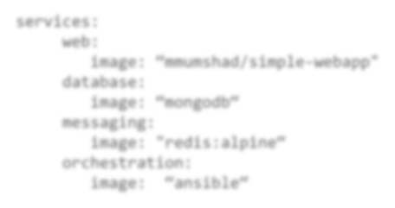



Docker compose
Public Docker registry - dockerhub
docker run mmumshad/simple-webapp
docker run mongodb
docker run redis:alpine
docker run ansible
docker-compose.yml
services:
web:
image: “mmumshad/simple-webapp"
database:
image: “mongodb“
messaging:
image: "redis:alpine“ orchestration:
image: “ansible“
docker-compose up

Slide 64
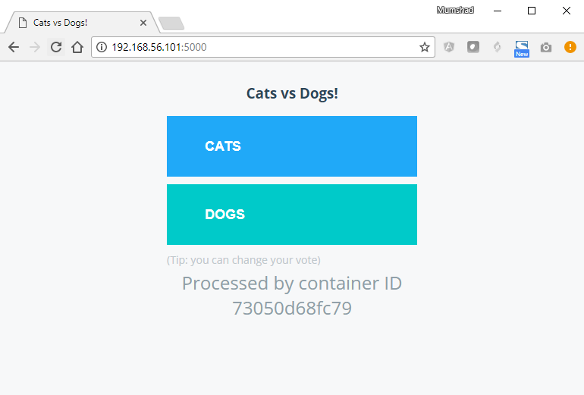
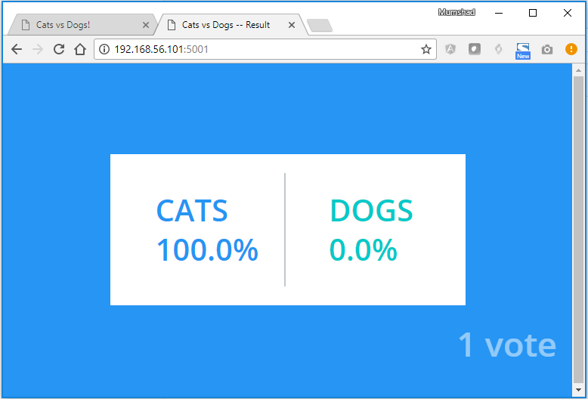




Sample application –
voting-app
python
C
in-memory DB
voting application
result-app
NodeJS
db
PostgreSQL
CATS | DOGS
1 | 0
CATS
DOGS
0
0
worker
.NET

Slide 65














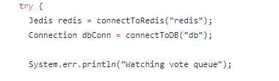
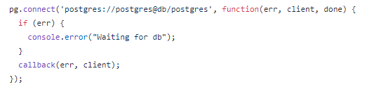
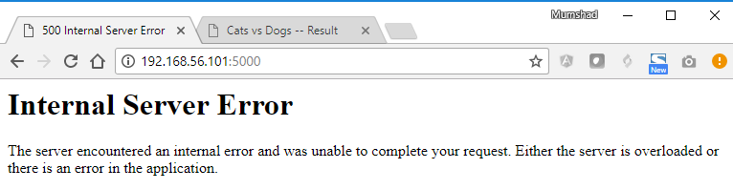
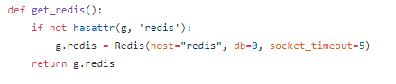
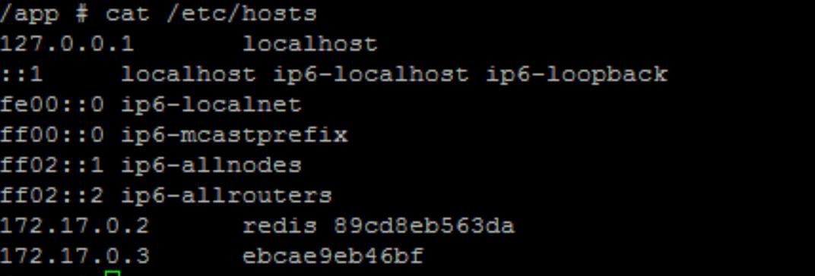
docker run --links
docker run -d --name=redis redis
voting-app
result-app
docker run -d --name=db
docker run -d --name=vote –p 5000:80
voting-app
--link redis:redis
docker run -d --name=result –p 5001:80
--link db:db
in-memory DB
db
result-app
docker run -d --name=worker
--link db:db --link redis:redis
worker
worker
! Deprecation Warning

Slide 66



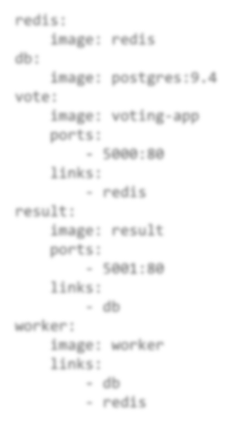
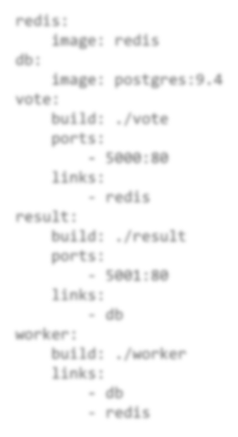

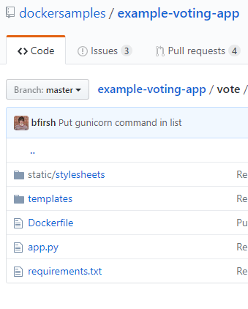
Docker compose - build
docker-compose.yml docker-compose.yml
redis:
image: redis
db:
image: postgres:9.4 vote:
redis:
image: redis
db:
image: postgres:9.4 vote:
image: voting-app build: ./vote
ports:
- 5000:80
links:
- redis
result:
ports:
- 5000:80
links:
- redis
result:
image: result build: ./result
ports:
- 5001:80
links:
- db
worker:
ports:
- 5001:80
links:
- db
worker:
image: worker build: ./worker
links:
db
redis
links:
db
redis

Slide 67






Docker compose - versions
docker-compose.yml
docker-compose.yml
docker-compose.yml
redis:
image: redis
db:
image: postgres:9.4 vote:
image: voting-app
ports:
- 5000:80
links:
-- rreeddiiss
version: 2
services:
redis:
image: redis
db:
image: postgres:9.4 vote:
image: voting-app
ports:
- 5000:80
depends_on:
- redis
version: 3
services:
version: 1
version: 2
version: 3

Slide 68


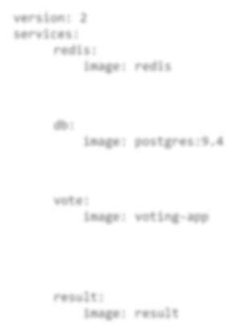

Docker compose
docker-compose.yml
version: 2 services:
redis:
image: redis
networks:
front-end
voting-app
result-app
back-end
image: postgres:9.4
networks:
back-end
vote:
image: voting-app
networks:
front-end
back-end
result:
image: result
networks:
front-end
back-end
networks:
front-end: back-end:
db:
redis
db
back-end
worker

Slide 69

d o c k e r
registry

Slide 70

Image
docker run nginx

Slide 71


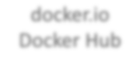
Image
docker.io Docker Hub
image:
docker.io/ nginx/nginx
Registry User/ Image/
Account Repository
gcr.io/ kubernetes-e2e-test-images/dnsutils

Slide 72

Private Registry
docker login private-registry.io
Login with your Docker ID to push and pull images from Docker Hub. If you don't have a Docker ID, head over to https://hub.docker.com to create one.
Username: registry-user
Password:
WARNING! Your password will be stored unencrypted in /home/vagrant/.docker/config.json.
Login Succeeded
docker run private-registry.io/apps/internal-app

Slide 73



Deploy Private Registry
docker run -d -p 5000:5000 --name registry registry:2
docker image tag my-image localhost:5000/my-image
docker push localhost:5000/my-image
docker pull localhost:5000/my-image
docker pull 192.168.56.100:5000/my-image

Slide 74

d o c k e r
engine

Slide 75




Docker Engine
Docker Engine
Laptop
Docker CLI
REST API
Docker Deamon
docker –H=remote-docker-engine:2375
docker –H=10.123.2.1:2375 run nginx

Slide 76




containerization
Process ID
Unix Timesharing
Network
Namespace
Mount
InterProcess

Slide 77
Namespace - PID
Linux System
PID : 1
PID : 2
PID : 3
Child System (Container)
PID : 4
PID : 5
PID : 1
PID : 6
PID : 2

Slide 78




cgroups
Linux System
Docker
Container
Docker
Container
Docker
Container
CPU
Memory
docker run --cpus=.5 ubuntu
docker run --memory=100m ubuntu

Slide 79

d o c k e r
On Windows

Slide 80
Docker on windows
Docker on Windows using Docker Toolbox
Docker Desktop for Windows

Slide 81


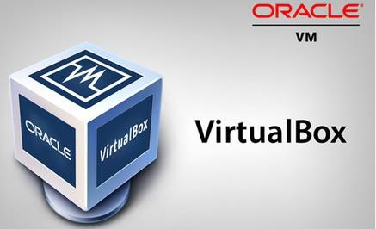
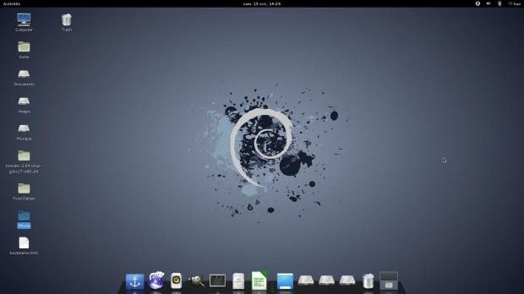

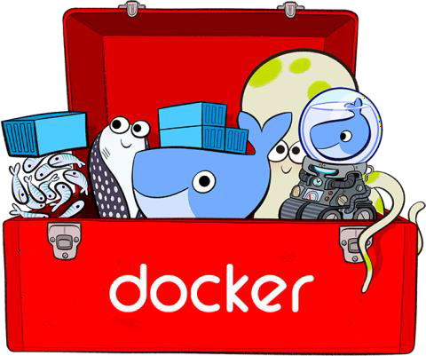
1. Docker toolbox
64-bit operating
Windows 7 or higher.
Virtualization is enabled
Oracle Virtualbox
Docker Engine
Docker Machine
Docker Compose
Kitematic GUI

Slide 82


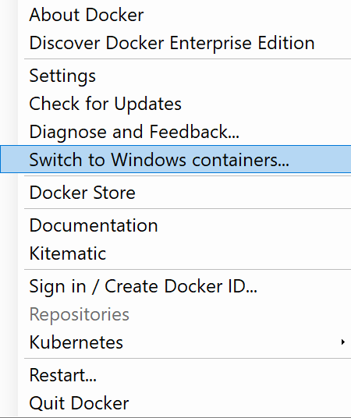
2. Docker Desktop for Windows
Support: Windows 10 Enterprise/Professional Edition Windows Server 2016
Linux Containers (Default) Or
Windows Containers

Slide 83
Windows containers
Container Types:
Windows Server
Hyper-V Isolation
Container
Container
Container
Container
Container
Container
Kernel
Kernel
Kernel
Kernel
Kernel
Base Images:
Windows Server Core
Nano Server
Support
Windows Server 2016
Nano Server
Windows 10 Professional and Enterprise (Hyper-V Isolated Containers)

Slide 84
VirtualBox Or Hyper-V

Slide 85

d o c k e r
On Mac

Slide 86
Docker on Mac
Docker on Mac using Docker Toolbox
Docker Desktop for Mac

Slide 87

1. Docker toolbox
macOS 10.8 “Mountain Lion” or newer
Oracle Virtualbox
Docker Engine
Docker Machine
Docker Compose
Kitematic GUI

Slide 88


2. Docker Desktop for Mac
Support: macOS Sierra 10.12 or newer
Mac Hardware - 2010 model or newer
Linux Containers

Slide 89

container
o r c h e s t r a t i o n

Slide 90




Why Orchestrate?
Public Docker registry - dockerhub
docker run nodejs
docker run nodejs docker run nodejs docker run nodejs

Slide 91




Container Orchestration
docker service create nodejs
-–replicas=100

Slide 92









Container Orchestration
docker service create nodejs
-–replicas=100

Slide 93

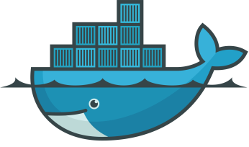
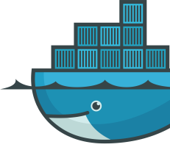
d o c k e r
swarm

Slide 94




Solutions
Docker Swarm

Slide 95
Docker swarm
Docker Swarm
Docker Host
Docker Host
Docker Host
Docker Host
Web
Container
Web
Container
Web
Container
Web
Container
Web
Container
MySQL
Container

Slide 96
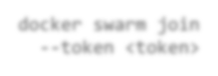







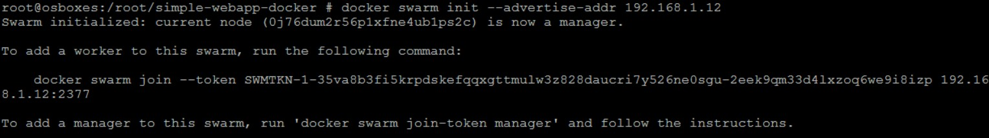
Setup swarm
Node
Worker
Node
Worker
Node
Worker
Swarm Manager
Docker Host
Docker Host
Docker Host
Docker Host
docker swarm init
docker swarm join
--token <token>
docker swarm join
--token <token>
docker swarm join
--token <token>

Slide 97





Docker service
–-network frontend
docker service create -–replicas=3 my-web-server
docker service create -–replicas=3 –p 8080:80 my-web-server
docker run my-web-server
docker service create -–replicas=3 my-web-server
Docker Swarm
Docker Host
Worker Node
Worker Node
Worker Node
Web Server
Web Server
Web Server
Web Server

Slide 98



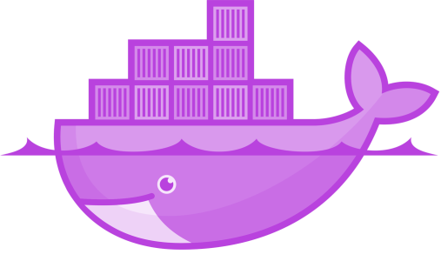

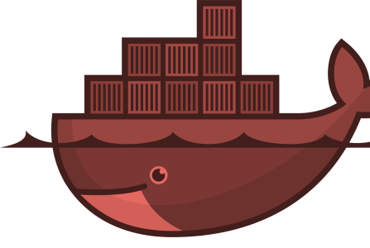

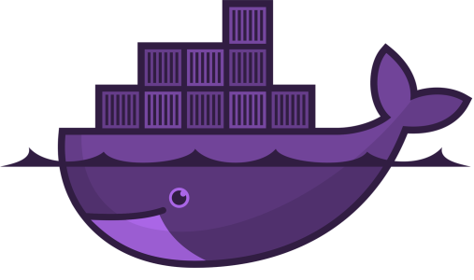

kubernetes

Slide 99

























--rollback
kubectl rolling-update my-web-server
rolling-update
kubectl my-web-server --image=web-server:2
-–replicas=2000
kubectl scale my-web-server
docker run my-web-server
kubectl run
-–replicas=1000
my-web-server
A
B
Docker Host
Node
Node
Node
Kubernetes Cluster
POD AutoScalers Cluster AutoScalers
Security
Network Storage

Slide 100




Nodes (Minions)
Node

Slide 101



Cluster
Node Node
Node

Slide 102











Master
Master
Node
Node
Node

Slide 103



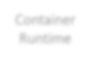










Components
ConAtPaiIner
Key-value store
CSckohuKneebutrdceboduleellet r
RSuenrtvimere

Slide 104







Master vs Worker Nodes
</> kube-apiserver
</> kubelet
etcd
controller
scheduler
Container Runtime
Master
Worker Node
CRI-O

Slide 105





kubectl
kubectl run hello-minikube
kubectl cluster-info
kubectl get nodes
kubectl run my-web-app --image=my-web-app --replicas=100

